Slide 1

Capstone Project – Sales Analysis

Slide 2
Sales Analysis Customer Analysis Order Analysis Employees Analysis Product Analysis Supplier Analysis Dashboard
📊 Valuable Insights:
The Power BI dashboard using the Northwind database provides valuable insights into the company’s sales performance, customer behavior, and operational efficiency. It presents data-driven analytics on orders, products, and suppliers, enabling stakeholders to gain a deeper understanding of key business trends, best-selling products, and revenue growth strategies.
🚀 Improvement Focus:
The dashboard helps Northwind Traders identify areas for improvement by analyzing order trends, shipping efficiency, and supplier performance. By evaluating sales patterns and customer demand, the company can refine its pricing strategy, optimize inventory management, and enhance supplier relationships to improve overall business performance.
📈 Evaluation of Effectiveness:
This dashboard enables the assessment of the company’s sales effectiveness by analyzing revenue distribution, customer segmentation, and employee contributions. It helps measure the impact of shipping partners, discount strategies, and regional sales trends, allowing the company to make data-driven decisions to maximize profitability.
📊 Trend Identification:
Using historical sales data and customer purchase behaviors, the dashboard identifies trends in product sales, seasonal demand fluctuations, and regional sales differences. It enables the company to anticipate market demand, adjust inventory levels accordingly, and optimize supply chain strategies for better forecasting.
🔍 Comprehensive Understanding:
The Power BI dashboard offers a complete overview of Northwind Traders’ business operations. By consolidating sales, customer, and supplier data into a centralized platform, stakeholders can make informed decisions, enhance customer relationships, and develop a strategic roadmap for sustainable growth.

Slide 3
🎯Objective:Analyze Northwind sales data to uncover key business insights, optimize sales strategies, and improve operational efficiency. 📊 Analysis Scope: Covers customer distribution, order trends, product sales, supplier insights, and employee performance using Power BI visualizations. 🚀 Goal: Provide actionable insights through data-driven analysis to optimize sales performance and operational efficiency.

Slide 4
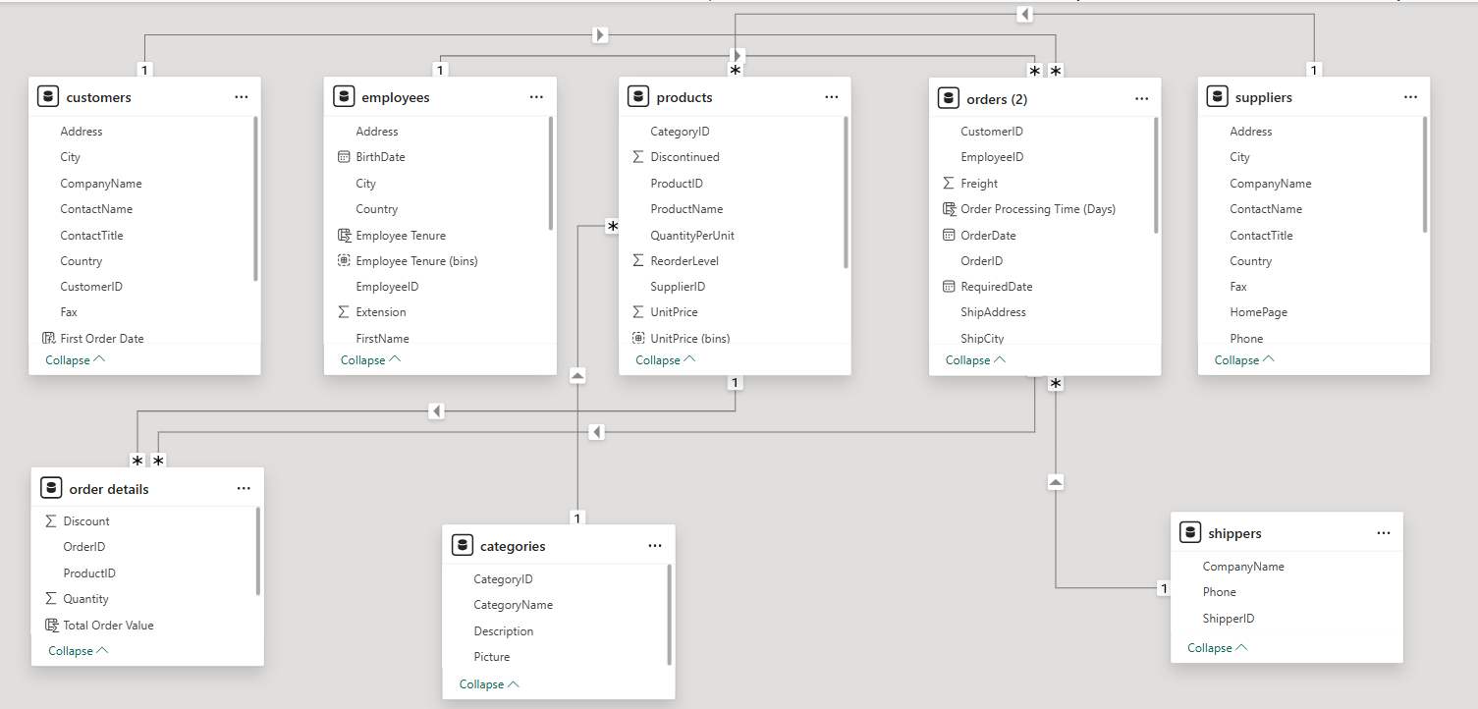
ER Diagram:

Slide 5
Power BI Problem Statements:

Slide 6
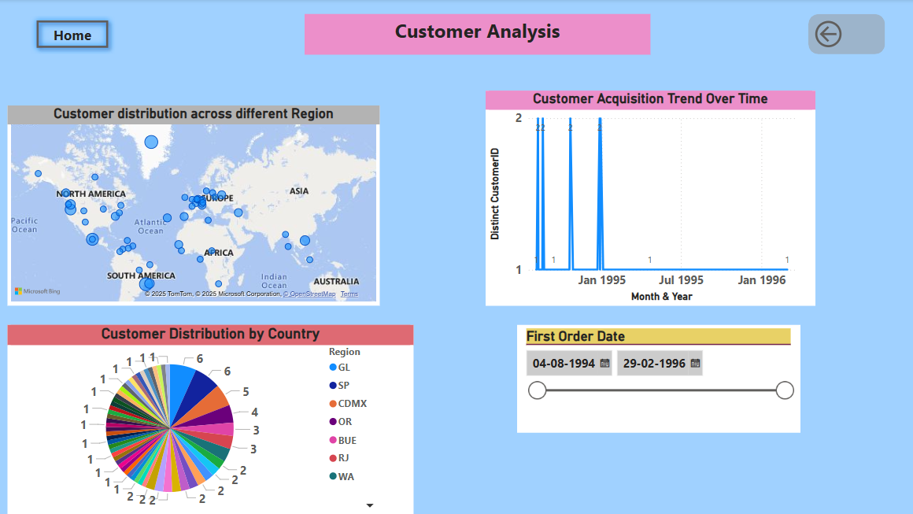

Slide 7
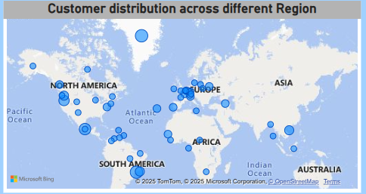
How does customer distribution vary across different regions or customer segments? Can we visualize it on a map or bar chart?
Conclusion:
Top Performing Regions: SP (49), GL (46), RJ (34), OR (28), CDMX (28) → High customer engagement and strong sales performance.
Best Among Low Order Regions: WA (19), ID (31), ST (30), SN (33), RJ (34) → Decent performance despite lower overall ranking.
Insights:
✔️ Leverage high-performing regions for targeted marketing and expansion. ✔️ Identify factors contributing to moderate success in some low-order regions. ✔️ Strategize sales efforts to improve engagement in underperforming regions.
Would you like a visual breakdown of these insights? 🚀

Slide 8
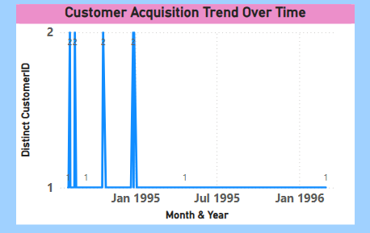
What is the trend in customer acquisition over time? Can we create a line chart or area chart to display it?
Conclusion on Customer Acquisition Trend:
The trend shows sporadic customer acquisitions with sharp peaks in early 1995, followed by a flat line for most of the timeline.
This indicates inconsistent new customer onboarding, with some months seeing multiple new customers while others have very few or none.
The lack of sustained growth suggests that customer acquisition was not continuous over time.
Recommendations:
✔️ Investigate factors contributing to the spikes—marketing campaigns, seasonal trends, or promotions. ✔️ Enhance acquisition strategies to ensure a steady flow of new customers.

Slide 9
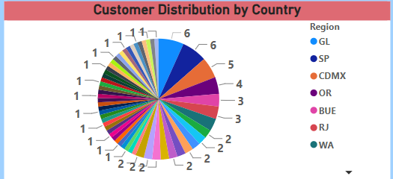
Can we visualize the distribution of customer demographics such as age, gender, or income using histograms or pie charts?
Conclusion:
Highly fragmented customer distribution across multiple regions.
No single region dominates significantly, but GL and SP have the highest customer counts.
Action: Focus on top-performing regions for targeted marketing and expansion

Slide 10
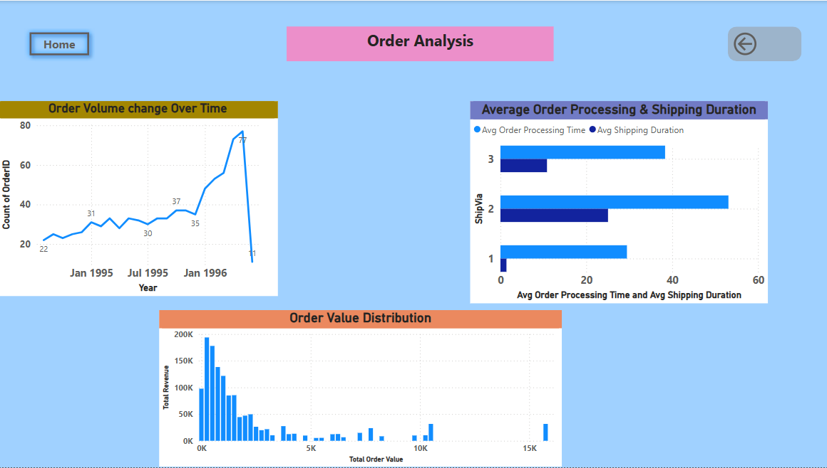

Slide 11
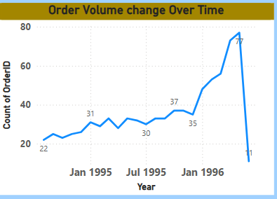
How does order volume change over time? Can we create a time series chart or stacked bar chart to visualize it?
Conclusion:
Consistent growth in order volume from early 1995 to early 1996, indicating increasing customer demand.
Sharp peak followed by a sudden drop, which may be due to seasonality, operational changes, or missing data.
Recommendation: Further analysis is needed to understand the cause of the decline and identify strategies to sustain high order volumes.

Slide 12
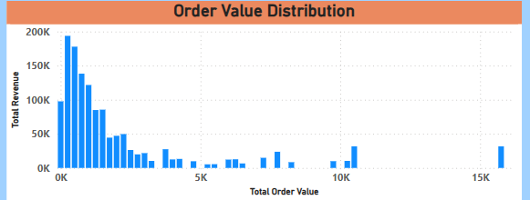
What is the distribution of order values? Can we create a histogram or box plot to display it?
Conclusion:
The order value distribution is right-skewed, with most orders having lower values and fewer high-value orders.
A significant portion of total revenue comes from low to mid-range order values, while a few high-value orders contribute substantially.
Recommendation: Focus on strategies to increase the frequency of mid-to-high-value orders to drive overall revenue growth.

Slide 13
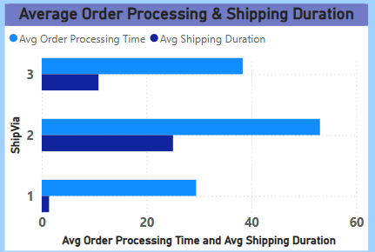
Can we visualize the average order processing time or shipping duration using a bar chart or box plot?
Conclusion:
Shipping duration varies significantly across different shipping methods, with ShipVia 2 having the longest shipping duration.
Order processing times remain relatively lower compared to shipping times, indicating that shipping is the main contributor to total order fulfillment time.
Recommendation: Optimize logistics and carrier selection to reduce shipping delays and improve delivery efficiency.

Slide 14
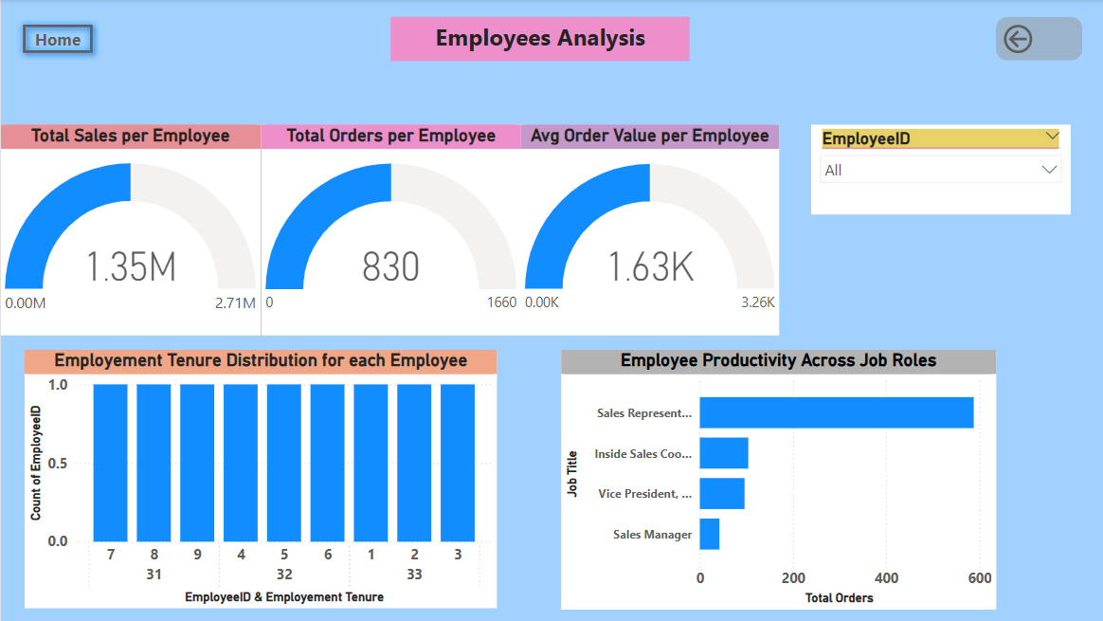

Slide 15
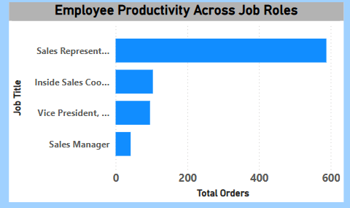
How does employee productivity vary across different departments or job roles? Can we create a stacked bar chart or grouped column chart to visualize it?
Conclusion:
Sales Representatives contribute the highest number of total orders, significantly outperforming other job roles.
Inside Sales Coordinators, Vice Presidents, and Sales Managers contribute relatively fewer orders, suggesting their roles may focus on strategy, supervision, or support rather than direct sales.
Recommendation: If the goal is to boost sales, investing in expanding or optimizing the Sales Representative team may yield higher results.

Slide 16
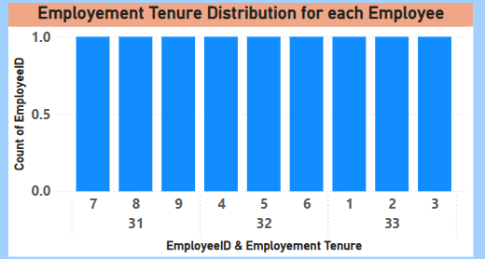
What is the distribution of employee tenure? Can we create a histogram or box plot to display it?
Conclude: We can clearly observed that Employee ID 1,2 and 3 are been working so long among the others .But the total Sales are low compared to others . we can clearly understand after going through each.

Slide 17
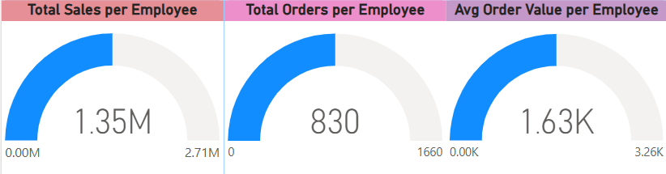
Can we visualize employee performance ratings or KPIs using a radar chart or bullet graph?
Top Performer: Employee 4 achieved the highest total sales ($250.19K) and a strong order volume (156 orders).
High Order Volume: Employee 9 processed the highest number of orders (443 orders) but had relatively lower total sales ($82.96K), indicating lower-value transactions.
Highest Average Order Value: Employee 7 had the highest average order value ($1.96K), showing efficiency in high-value sales.
Lowest Sales & Orders: Employee 5 had the lowest total sales ($75.57K) and the lowest number of orders (42 orders), suggesting room for improvement.
Overall, some employees excel in sales volume, while others generate higher-value transactions. Optimizing sales strategies based on individual performance can enhance overall productivity.

Slide 18
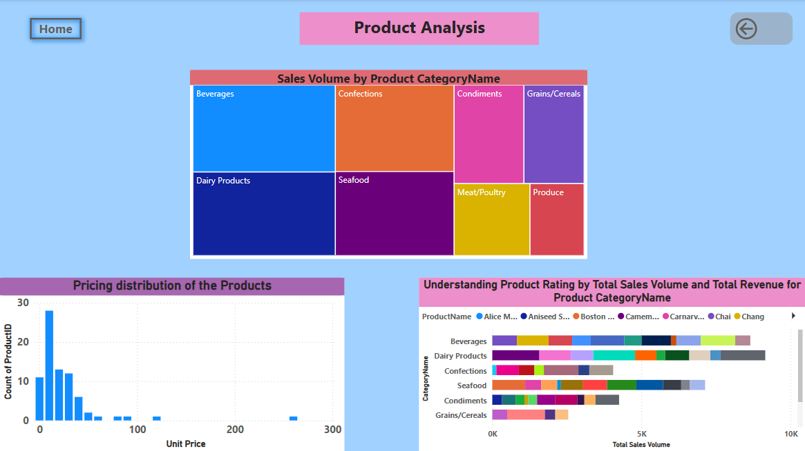

Slide 19
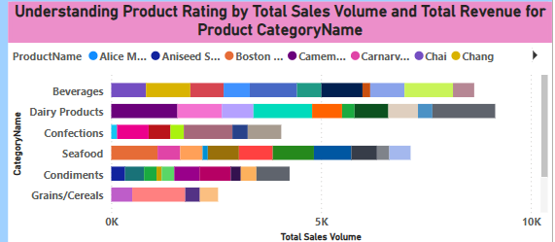
What is the distribution of product ratings or reviews? Can we create a histogram or stacked bar chart to visualize it?
Conclusion:
The visualization shows the total sales volume and revenue distribution across different product categories. Beverages, dairy products, and confections have significant contributions, with multiple products contributing to sales in each category. The sales are diversified across various product names, indicating a broad range of customer preferences. The highest sales volumes are seen in dairy products and beverages, suggesting they are the most popular categories.

Slide 20
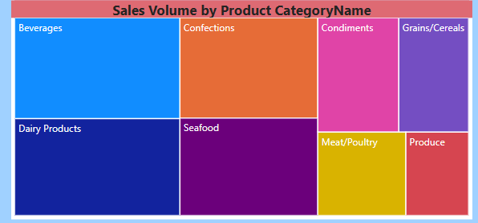
How does the sales volume vary across different product categories? Can we create a bar chart or treemap to display it?
Conclusion:
The treemap visualization effectively represents sales volume distribution across product categories. Beverages, dairy products, and confections appear to have the highest sales volume, indicating their strong market demand. Seafood, condiments, grains/cereals, meat/poultry, and produce contribute relatively less but still hold a significant share. This visualization helps in understanding which product categories are driving the most sales, aiding in inventory and sales strategy decisions.

Slide 21
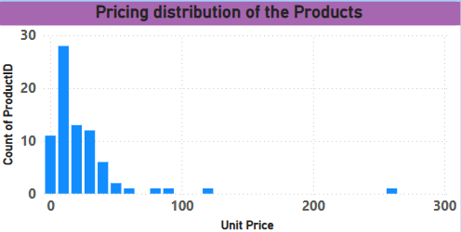
Can we visualize the pricing distribution of products using a box plot or violin plot?
Conclusion:
The histogram visualization shows that the majority of products have lower unit prices, with a high concentration below 50 units. As the price increases, the number of products decreases significantly, indicating that higher-priced products are less common. There are a few outliers with prices exceeding 200 units, suggesting a small segment of premium-priced products.

Slide 22
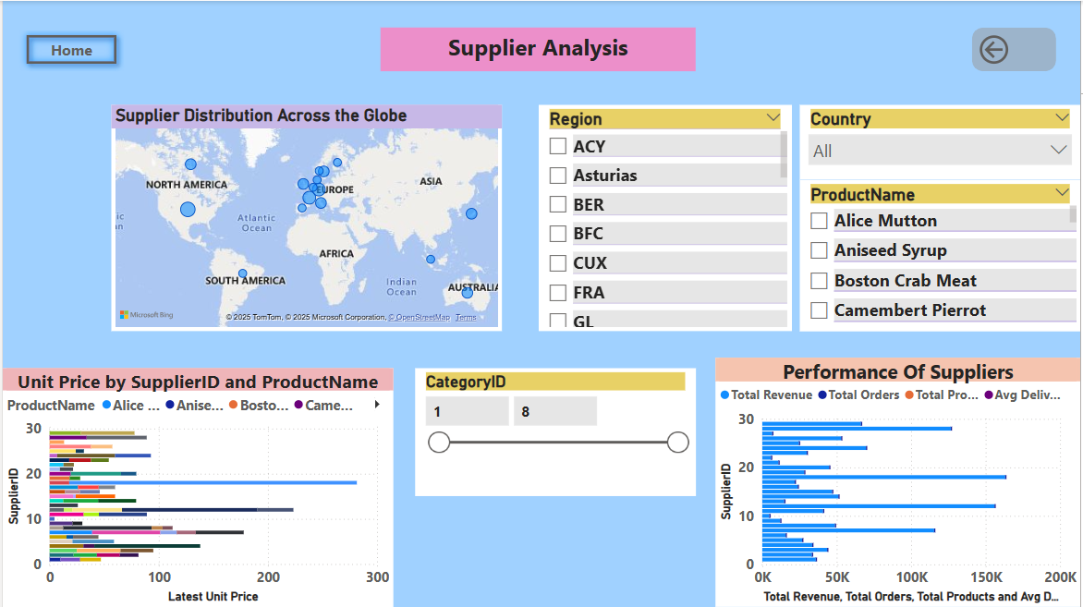

Slide 23
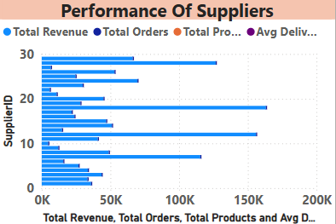
What is the distribution of supplier ratings or performance metrics? Can we create a bar chart or radar chart to visualize it?
Conclusion:
The bar chart provides insights into the performance of suppliers based on total revenue, total orders, total products, and average delivery metrics. There is a clear variation among suppliers, with some generating significantly higher revenue and orders compared to others. Supplier ID 18 appears to be the highest performer, followed by Supplier ID 12.

Slide 24
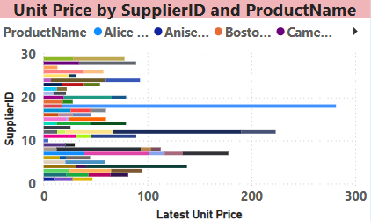
How does the cost or pricing structure vary across different suppliers? Can we create a box plot or stacked bar chart to display it?
Conclusion:
The unit price distribution across different suppliers shows significant variation, with some suppliers offering products at much higher prices. Supplier ID 18 & 12 has the highest unit price for a specific product, while most other suppliers have more balanced pricing structures.

Slide 25
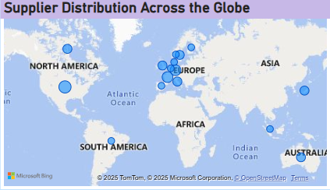
Can we visualize the geographical distribution of suppliers using a map or bubble chart?
Conclusion:
The supplier distribution across the globe is highly concentrated in Europe, as indicated by the larger and denser bubbles in that region. There are also suppliers in North America, South America, Asia, and Australia, but they are relatively fewer.
The bubble size represents the number of suppliers in a given location, and Europe has the highest concentration. A geographical heat map or an interactive map would be effective in further analyzing supplier density and regional trends.

Slide 26
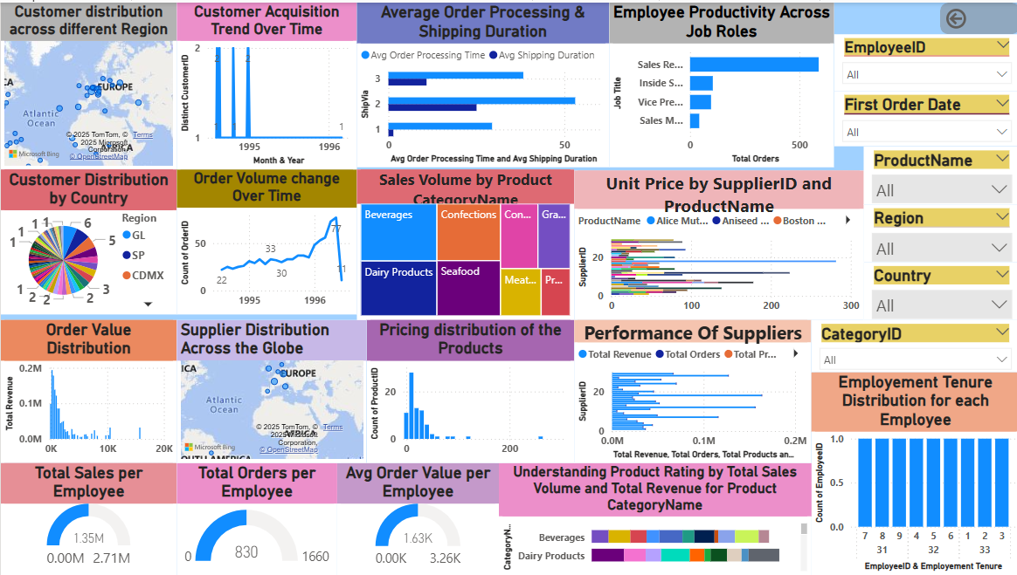

Slide 27
EDA Problem Statements

Slide 28
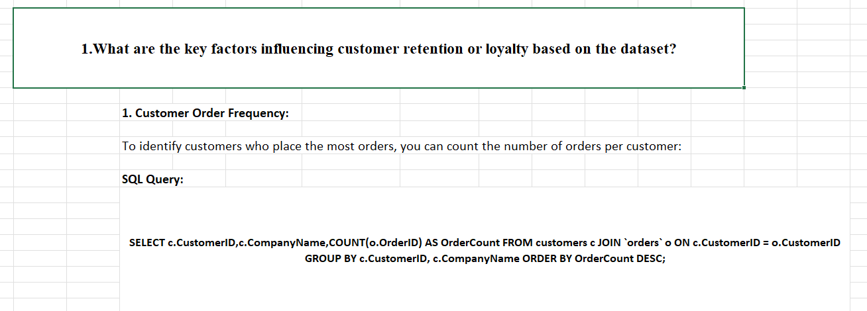
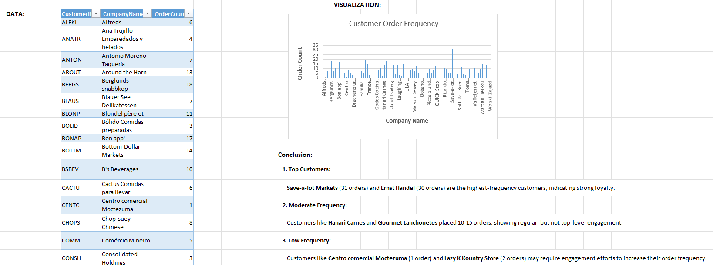

Slide 29
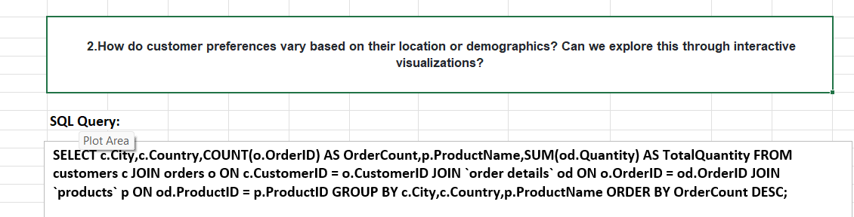
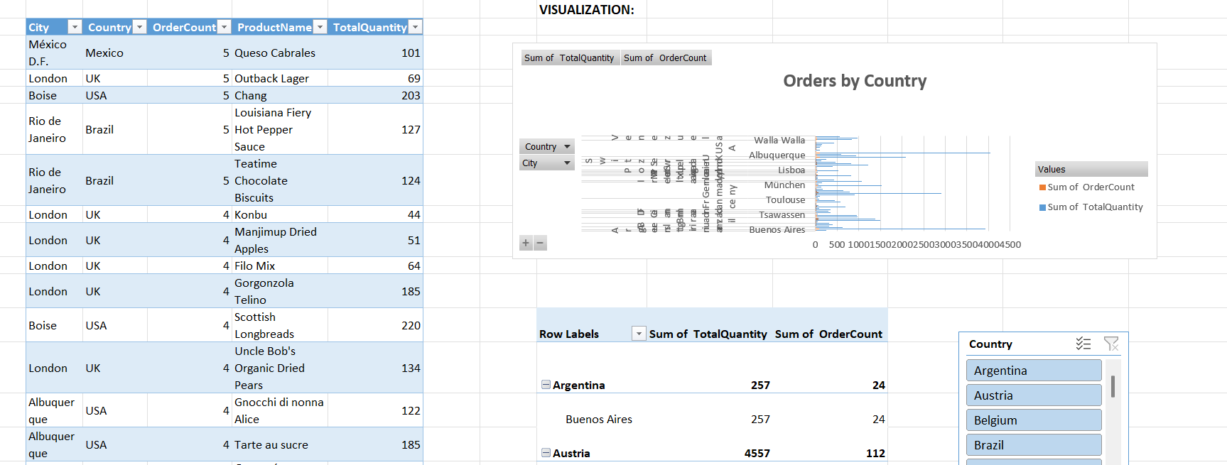
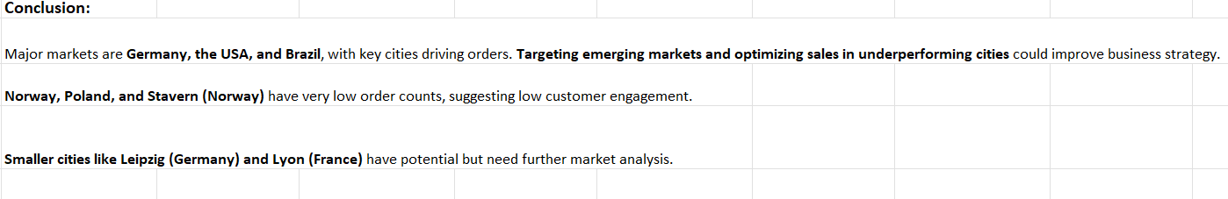

Slide 30
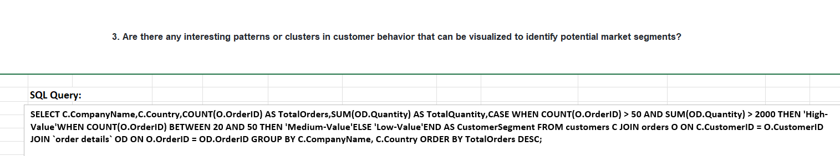
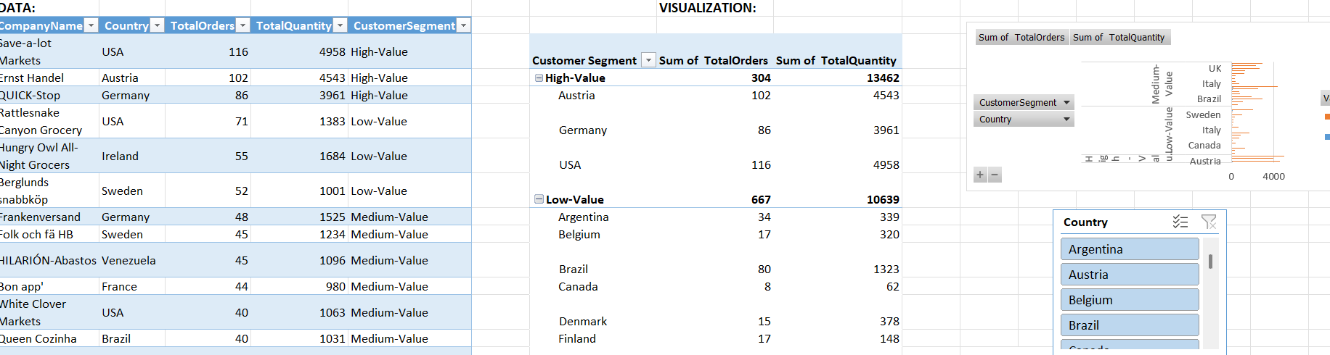
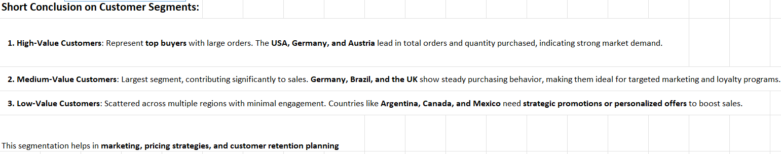

Slide 31
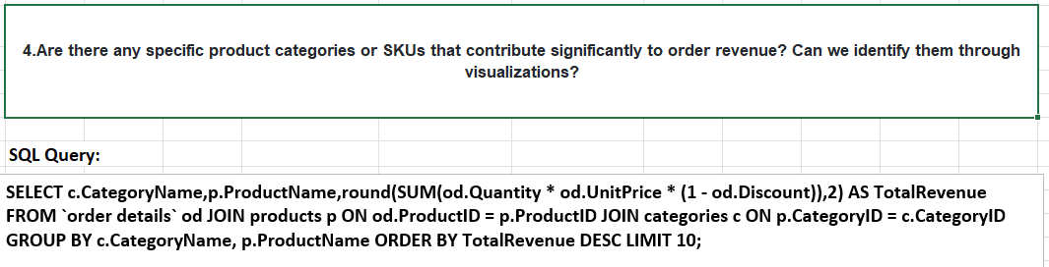
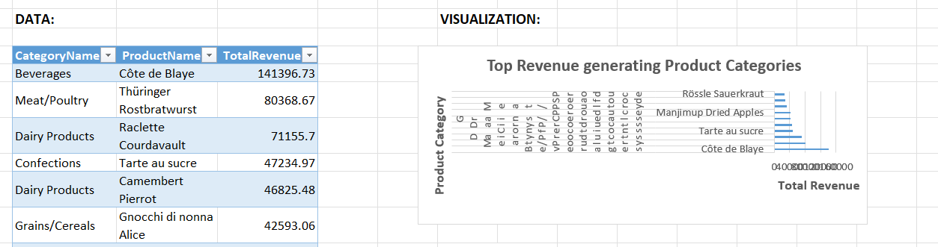
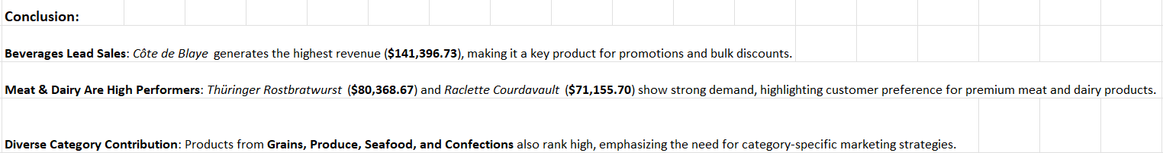

Slide 32
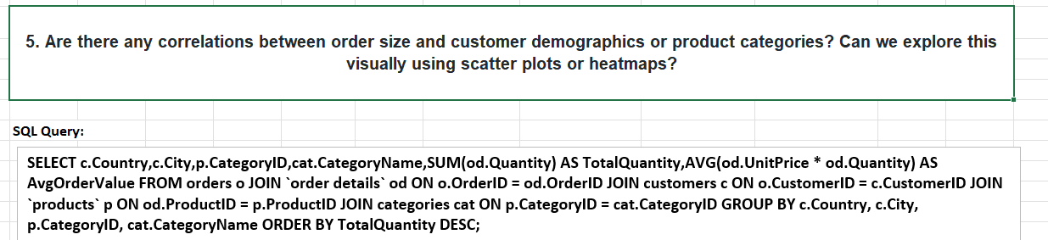
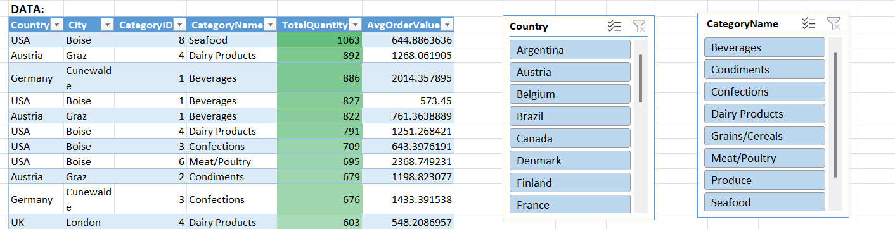
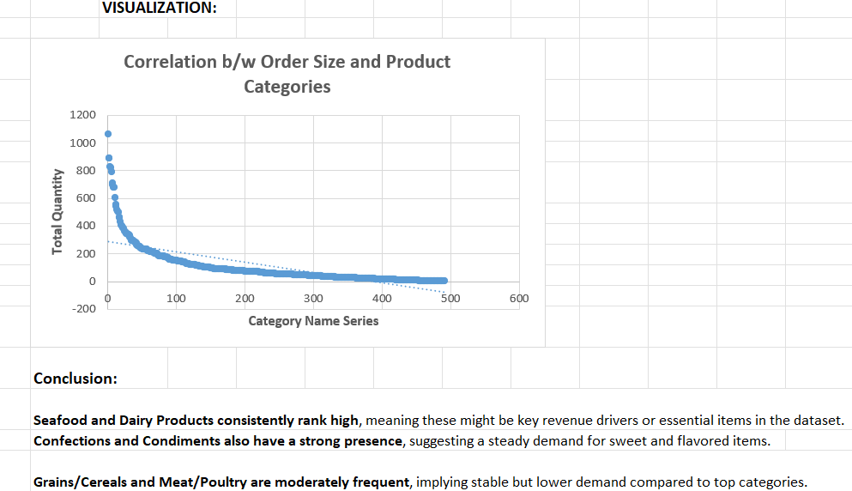

Slide 33
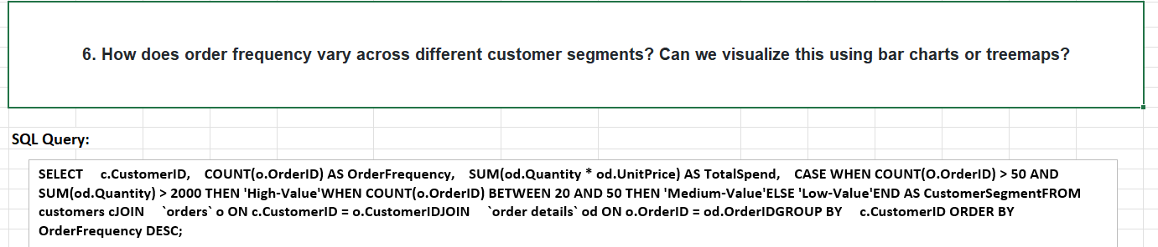
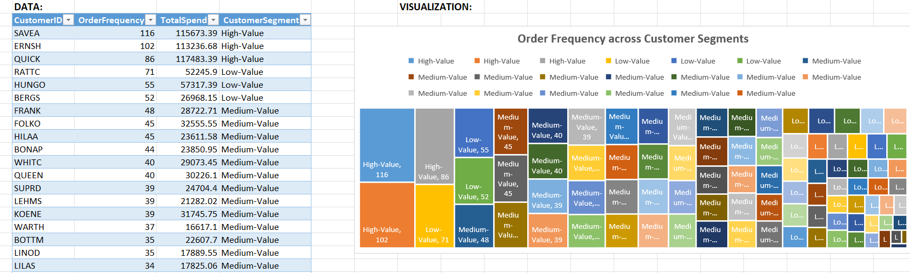
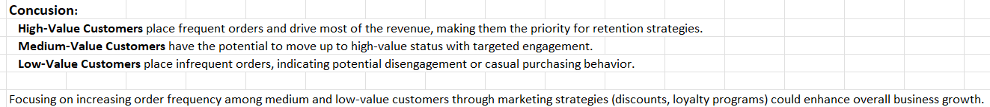

Slide 34
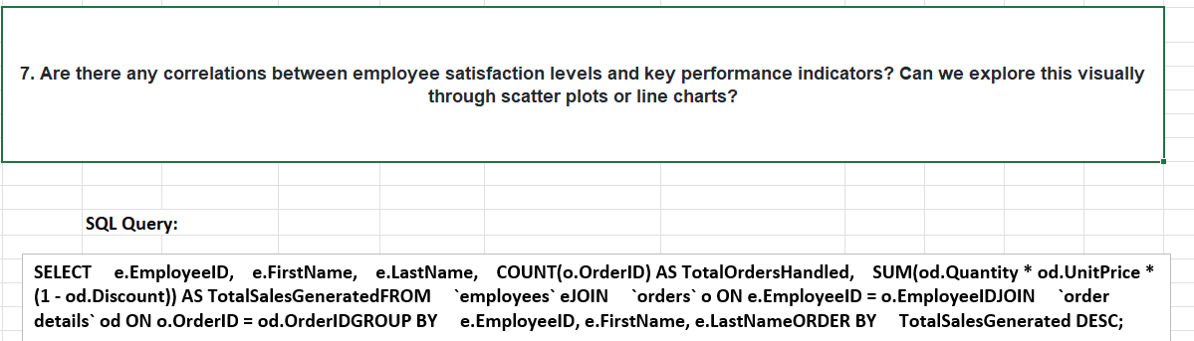
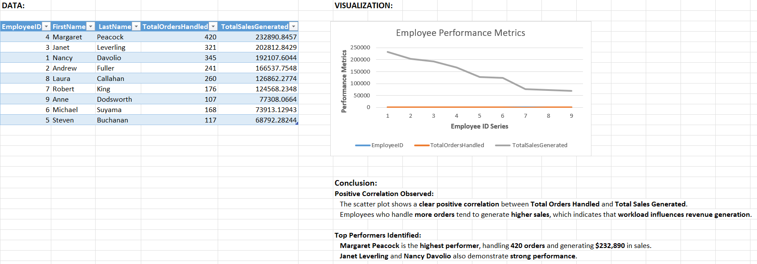

Slide 35
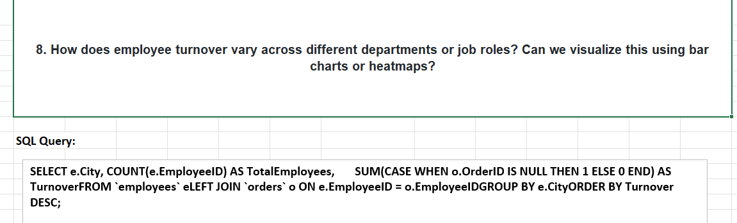
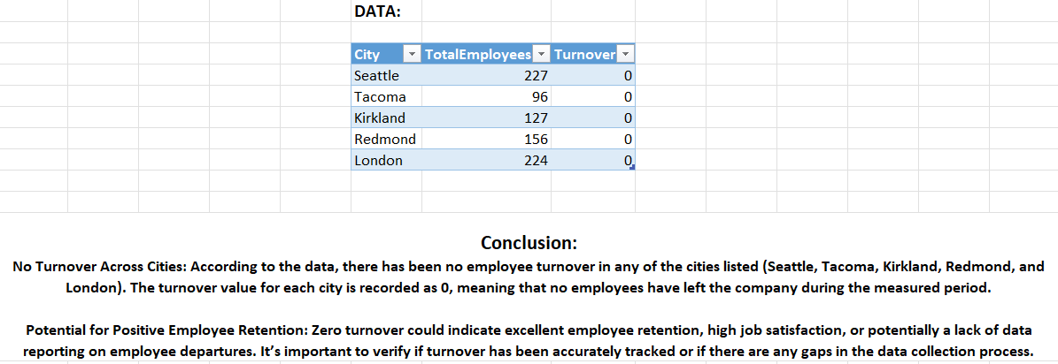

Slide 36
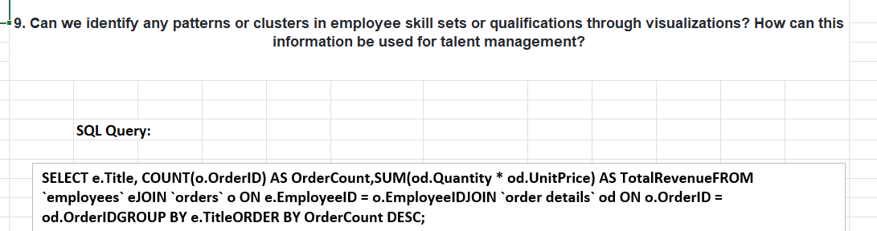
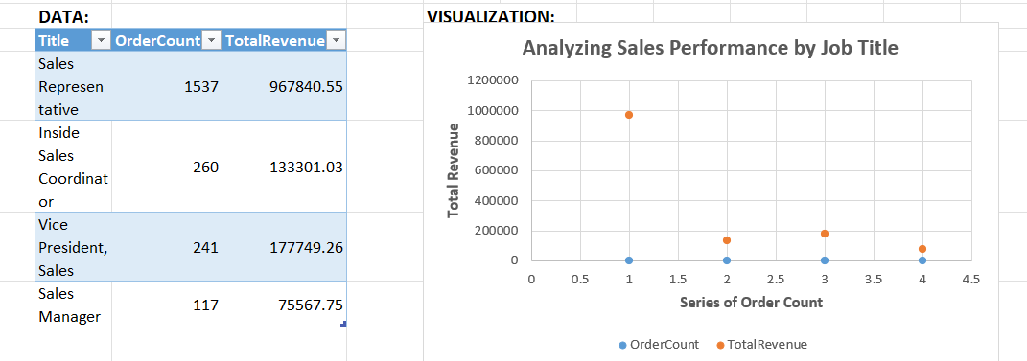
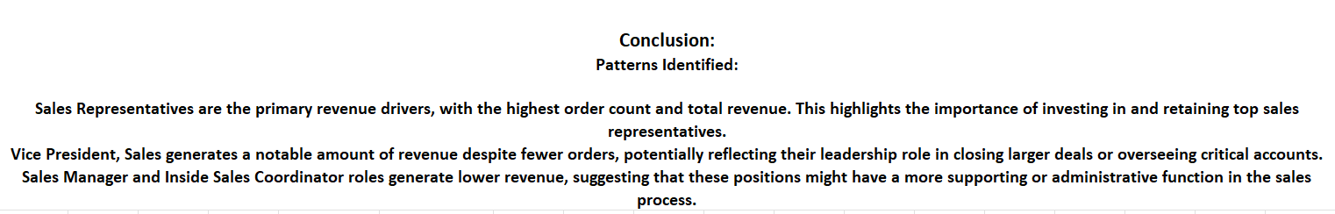

Slide 37
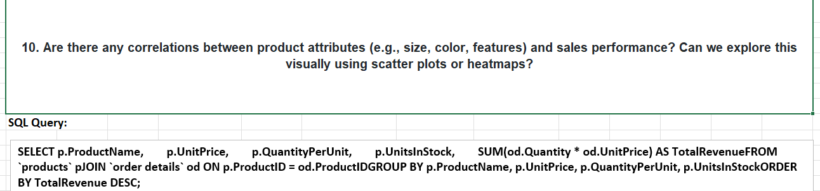
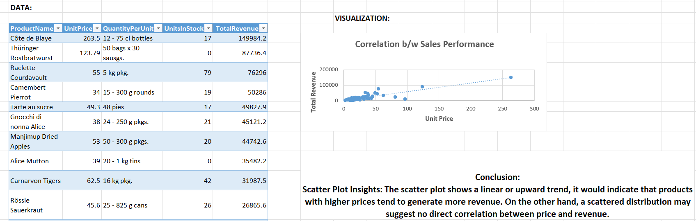

Slide 38
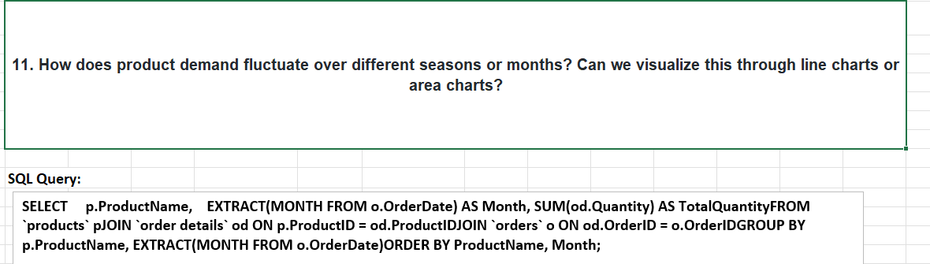
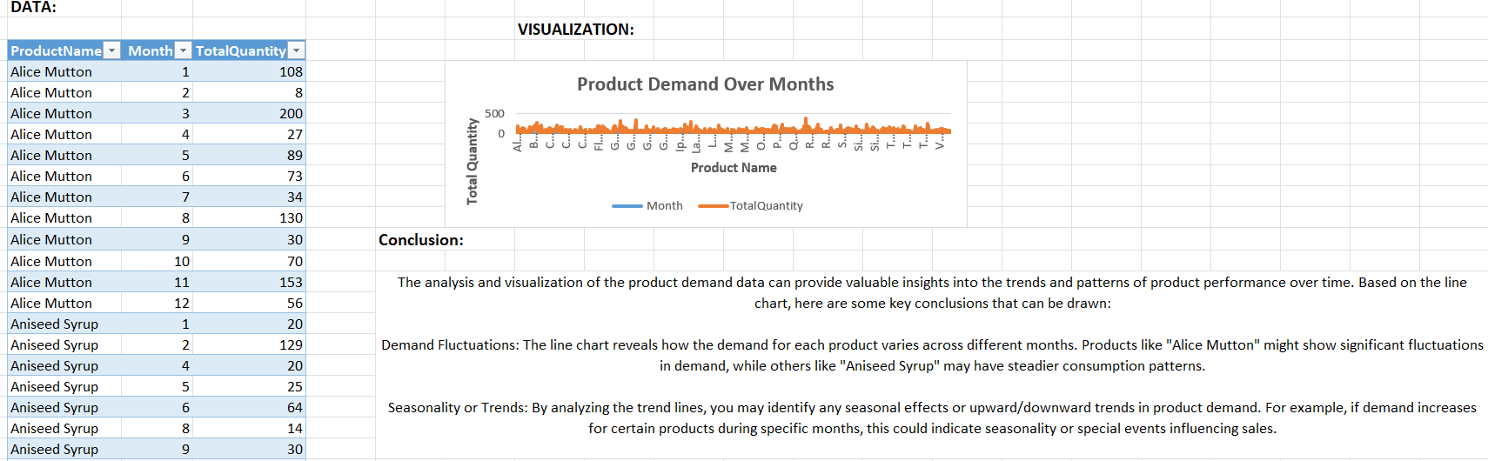

Slide 39



Slide 40



Slide 41




Slide 42




Slide 43
THE END 🙂

